Slide 1
Today is Thursday , May 28th Let’s Start our day and get moving with a good morning song https://www.youtube.com/watch?v=Xb29Js0wehg
Click the speaker on each page to hear instructions
Good Morning!
Today We will ………
Writing- Writing a story
Literacy- reviewing diagraphs and vowels
Math- reviewing counting faces and vertices of 3-D shapes

Slide 2
Small Group Schedule
 | Monday | Tuesday | Wednesday | Thursday | Friday
9:00 |  | Bryce/ Jayceon |  | Londyn M/ Julicia | No School
10:00 | Jayceon/ Grace |  | Class Zoom at 11:30 am
11:00 | Londyn R/ Naima |  |  | Marinda
1:00 | Devin (Duo) | Maki/ Armani |  | Trinity/ Karlie/ Ladarius

Slide 3
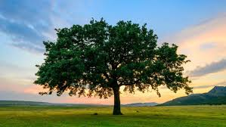
Writing
**Parents do not tell scholars how to spell words!! Encourage them to sound it out!! I am not looking for perfectly spelled words.***
Vocabulary Words to use
trees
20 minutes

Slide 4
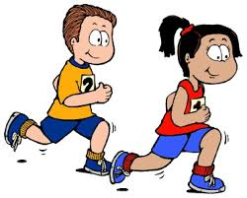
Brain Break
10 of each exercise

Slide 5
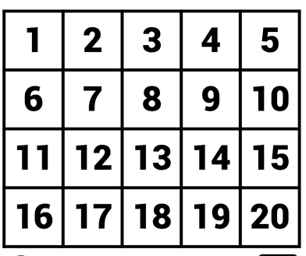
Number review

Slide 6
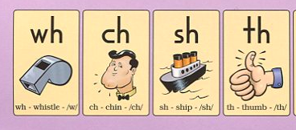
Literacy
Diagraph review

Slide 7
Literacy
Vowels have two sounds long and short.
Aa Ee Ii Oo Uu

Slide 8
Sight Word Review
See | The | Was | he
They | We | There | my
She | can | will | go
For | When | her | you
was | our | away | have

Slide 9
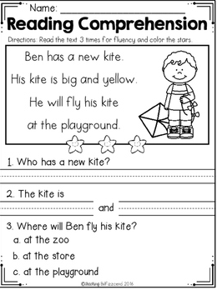
Comprehension assignment

Slide 10
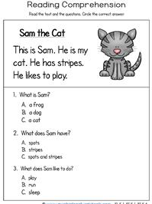
Comprehension assignment

Slide 11
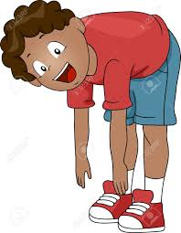
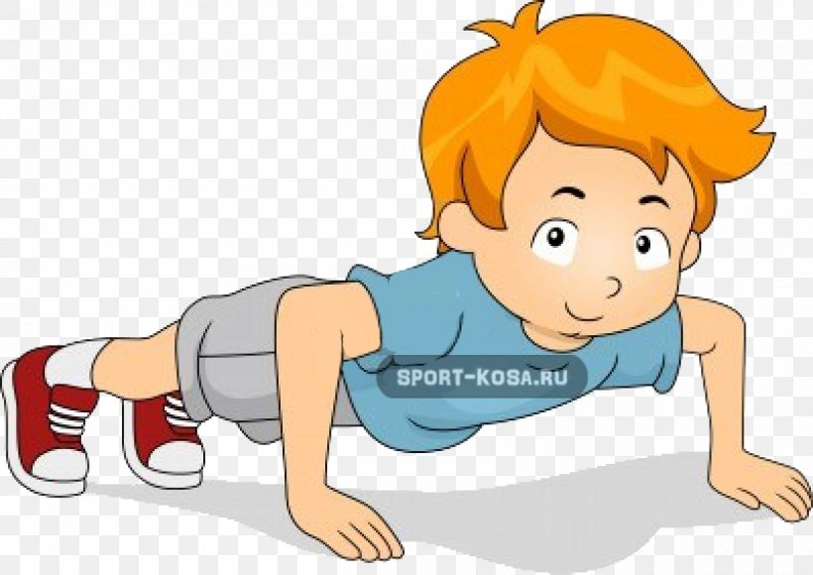
Brain Break
10 of each exercise

Slide 12
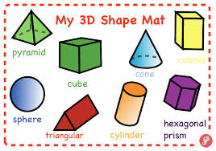
Math
3-D Shapes
3-D shapes are not flat. They are solid.
Identify and describe shapes.
NC.K.G.1 Describe objects in the environment using names of shapes, and describe the relative positions of objects using positional terms

Slide 13
Math
3-D Shapes
3-D shapes have faces and verticies
Vertices
Cube
face
Identify and describe shapes.
NC.K.G.1 Describe objects in the environment using names of shapes, and describe the relative positions of objects using positional terms

Slide 14
Assignment
Please send me a picture of the comprehension assignment

Slide 15
Awesome Work Today!!!
See you tomorrow!!

