Slide 1
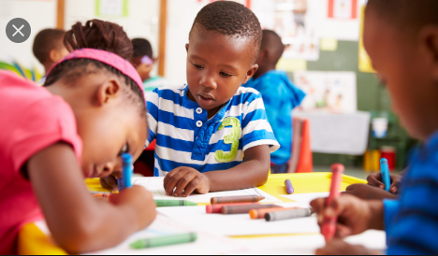
Kindergarten
Wednesday
May 27th
Ms. Verdell’s Class

Slide 2
Today is Wednesday, May 27th Let’s Start our day and get moving with a good morning song https://www.youtube.com/watch?v=Xb29Js0wehg
Click the speaker on each page to hear instructions
Good Morning!
Today We will ………
Writing- Write sentences by sounding out words
Literacy- Practice with digraphs as ending sounds
Math- Number Review

Slide 3
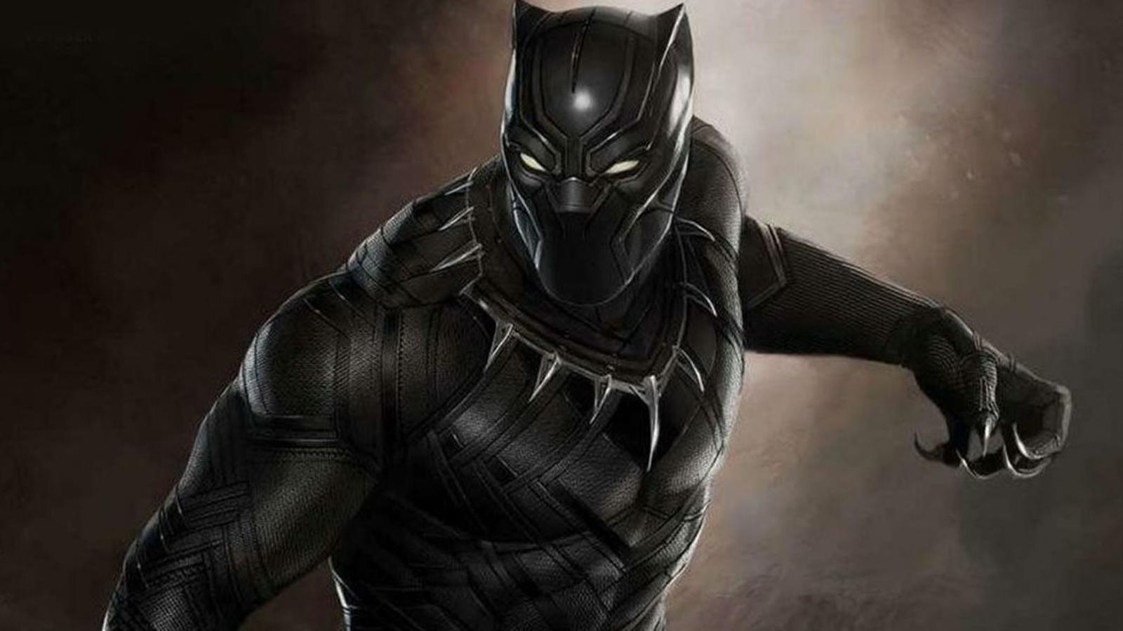
Writing
Vocabulary Words to think about
hero
20 minutes

Slide 4
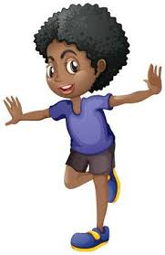
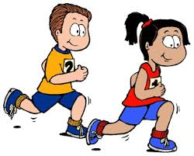
Brain Break
10 of each exercise

Slide 5
Literacy
Diagraph review

Slide 6
Literacy
Sounding out words
ch | i | ck
B | u | sh

Slide 7
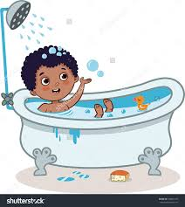
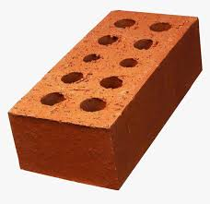
Literacy
Practice
Spelling words
Please note that students need to sound words out.

Slide 8
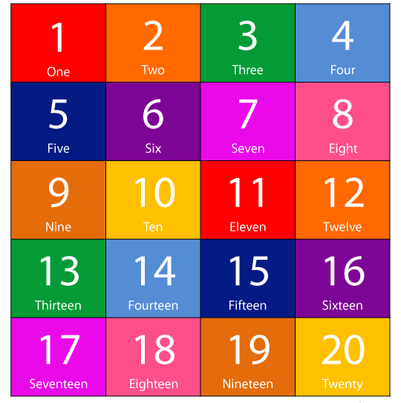
Number review

Slide 9
Math
Number Review
Please write the numbers in your notebook and draw items to match.
21 | 16 | 10 | 13
18 | 7 | 15 | 16
11 | 19 | 6 | 20

Slide 10
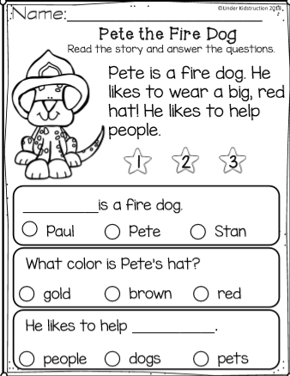
Comprehension

Slide 11
Assignment
Please send me a picture of math or literacy assignment

Slide 12
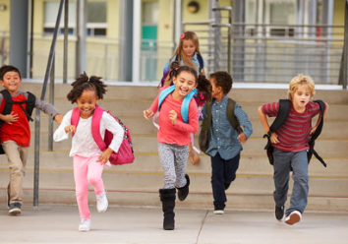
Awesome Work Today!!!
See you tomorrow!!

