Slide 1
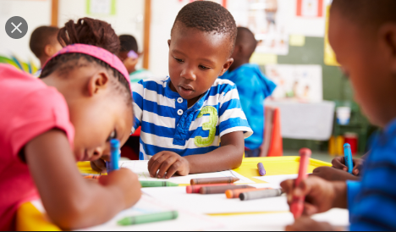
Kindergarten
May 26
Ms. Verdell’s Class

Slide 2

Today is Tuesday, May 26th
Let’s Start our day and get moving with a good morning song https://www.youtube.com/watch?v=Xb29Js0wehg
Click the speaker on each page to hear instructions
Good Morning!
Today We will ………
Writing- Write sentences by sounding out words
Core- Review the parts of a tree
Literacy- sounding out CVC words focusing on vowels “u” and “i”
Math- Measurable attributes

Slide 3
Small Group Schedule
 | Monday | Tuesday | Wednesday | Thursday | Friday
9:00 |  | Bryce/ |  | Londyn M/ Taylor | Jayceon Londyn R
10:00 |  |  | Class Zoom at 11:30 am
11:00 |  |  |  | LaDarius/ Marinda
1:00 |  | Maki/ Armani/ Naima |  | Trinity/ Karlie/ Grace/ Julicia
Click Link to Join:

Slide 4
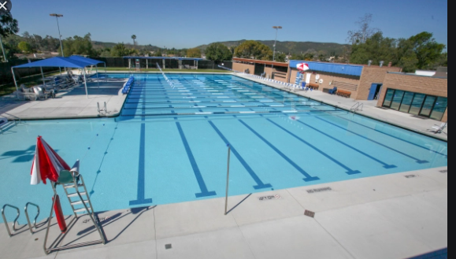
Writing
Vocabulary Words to use
Pool
Swim
20 minutes

Slide 5

Brain Break
https://www.youtube.com/watch?v=Pwn4beja1QE
https://www.youtube.com/watch?v=dx6wHN0VsJo

Slide 6
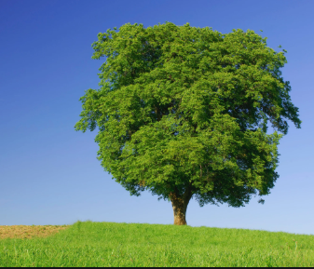
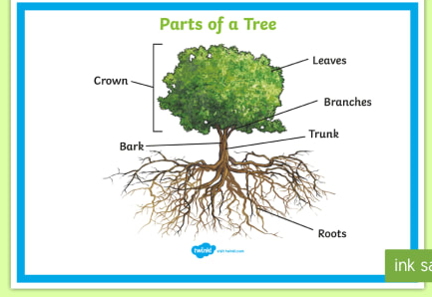

Core
Parts of a Tree
Roots – nutrients
Trunk – helps keep the tree sturdy
Bark – protects the trunk
Branches- where the leaves/ flowers/fruit grow
Leaves- how the tree breathes
Crown- top of the tree
Can you draw your own tree and label the parts?

Slide 7
Literacy
Vowels have two sounds long and short.
Aa Ee Ii Oo Uu

Slide 8
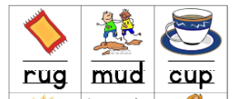

Literacy
Uu Ii
Aa Ee Ii Oo Uu

Slide 9

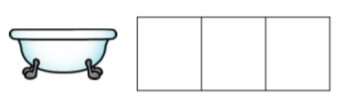




Literacy
Look at the pictures below. Sound out the word and write it.
Aa Ee Ii Oo Uu

Slide 10
Sight Word Review
See | The | Was | he
They | We | There | my
She | can | will | go
For | When | her | you
was | our | away | have

Slide 11
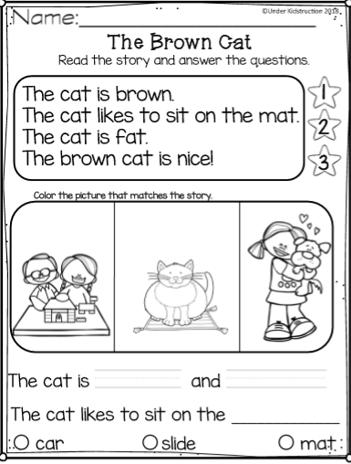
Reading Comprehension
Read the passage. Answer questions in notebook.

Slide 12

Brain Break
https://www.youtube.com/watch?v=1dkPouLWCyc

Slide 13
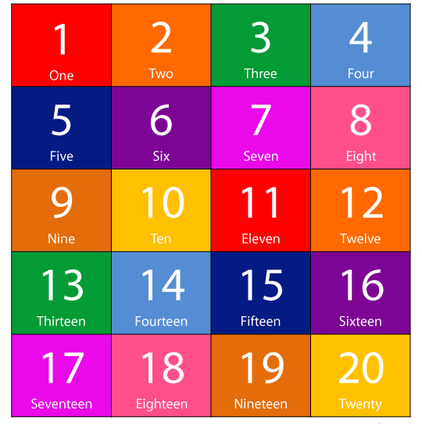
Number review

Slide 14
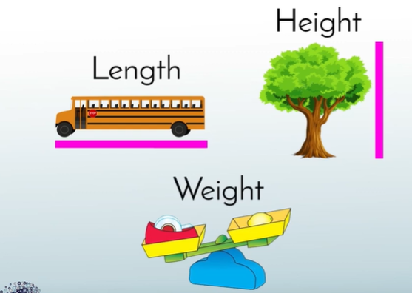
Math
Measurable Attributes
Describe and compare measurable attributes.
NC.K.MD.1 Describe measurable attributes of objects; and describe several different measurable attributes of a single object

Slide 15

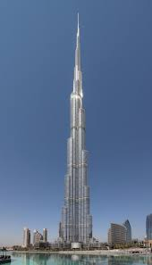
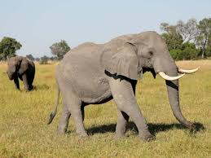
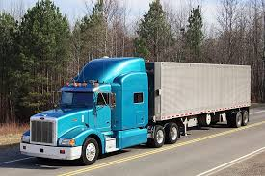
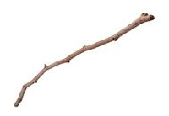
Practice
Point to each picture and describe it using measurable attributes.

Slide 16
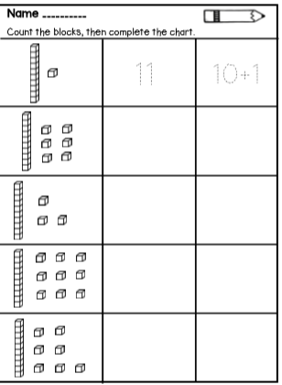
Math
Teen Numbers Review

Slide 17

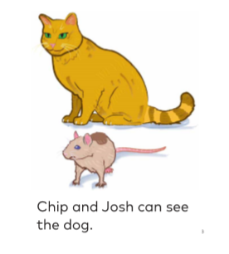

Decodable Reader
Please practice reading this decodable reading book everyday

Slide 18

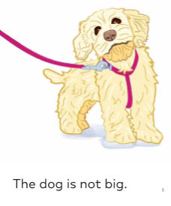


Decodable Reader

Slide 19
Assignment
Please send me a picture of the writing assignment

Slide 20
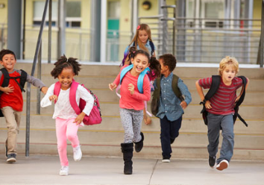
Awesome Work Today!!!
See you tomorrow!!

